Slide 1
Adaptive Noise Cancellation
This presentation covers the recent progress in data collection and LMS adaptive filtering implementation for noise reduction inside vehicle cabins. The focus was on acquiring IMU and microphone data under controlled static conditions with various noise combinations. The goal is to develop an effective adaptive filtering system to isolate external audio from engine noise.
We will explore data acquisition, stepwise LMS filtering, MATLAB implementation, observations, and next steps for refining the noise cancellation model.

Slide 2

Data Collection Under Controlled Noise Conditions
Noise Configurations
Future Aspects for Noise Scenarios
Car engine noise only
Collect new datasets where external audio is played in a repetitive, cyclic manner to rigorously test the adaptability of the filtering system over time.
Engine noise + external sound via internal speakers
Engine noise + external sound + ambient environmental sounds
From keeping vehicle static, to making it in motion and collecting data.
External sound (music) only
Recordings spanned from 30 seconds to 6 minutes to analyze the effect of signal length on adaptive filtering accuracy and convergence.

Slide 3
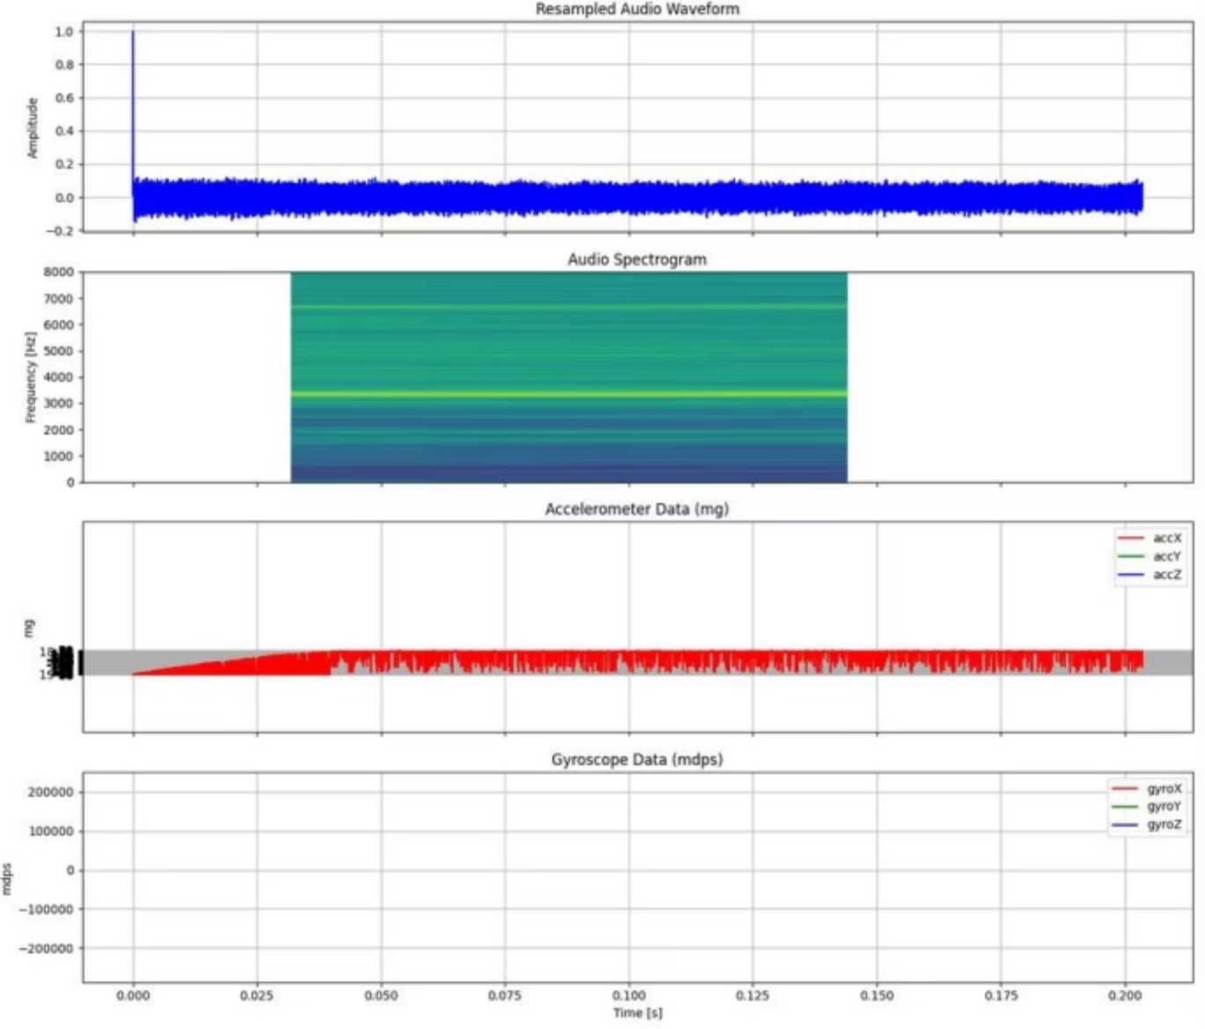
Data Visualization Using data collected by SensorTile.Box
Comprehensive View
Multi-subplot visualization showing:
Resampled audio waveform
Audio spectrogram
Accelerometer data (X, Y, Z)
Gyroscope data (X, Y, Z)

Slide 4
Data Collection: Vehicle in Motion
A crucial step involved collecting dynamic data with the vehicle in motion, moving beyond static and simulated conditions to replicate real-world automotive environments.
IMU Data Collection
Microphone Data Collection
Extensive Data Collection
Simulated IMU Data
IMU data (accelerometer and gyroscope) was collected using the LSM6DSV16BX sensor across various places and speeds. Each session lasted 2-3 minutes to manage file sizes while capturing ample motion variations.
Prioritized capturing data across various scenarios, specifically focusing on repetitive amplitude patterns to observe effects on adaptive filtering algorithms. Shifted emphasis to real-time data collection, actively generating noise in a controlled manner for suppression using adaptive filtering techniques.
Created simulated sound signals (1-3 minutes) mimicking engine noise and intermittent audio to evaluate LMS filter adaptability.
Microphone data captured engine noise combined with external audio (music/ambient sounds) in real time, emulating actual driving conditions for adaptive filtering and analysis.

Slide 5
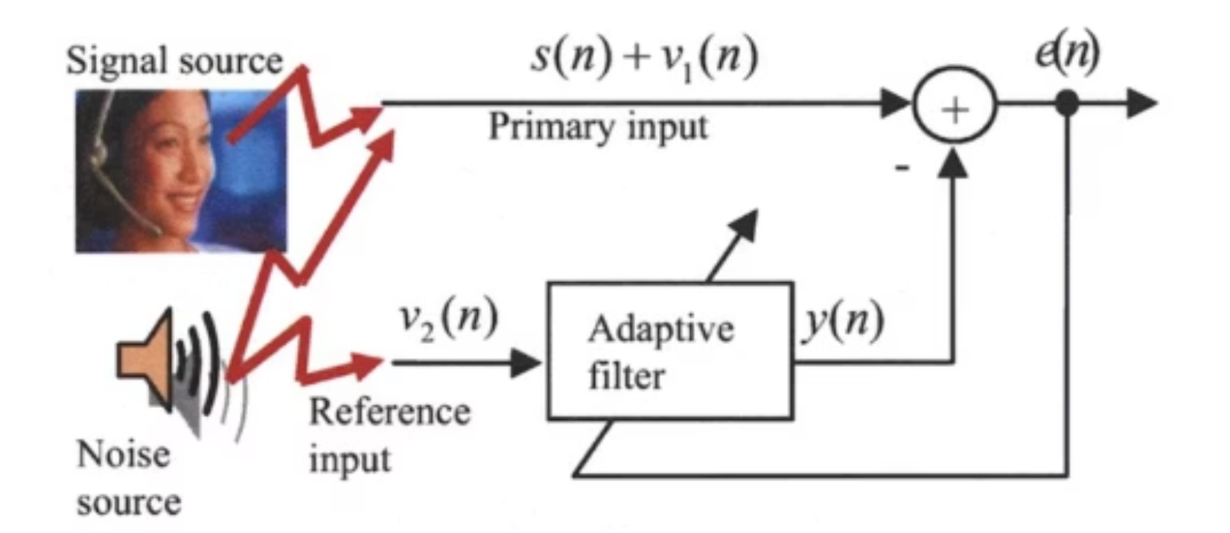
Brief Overview
S(n) : Sound of External Audio
V1(n) : Noise of Engine
V2(n) : Noise of Engine
f(n) : Adaptive Filter(LMS Filter) performed on V2(n)
From Signal Source : D(n) = S(n) + V1(n)
From Noise Source : y(n) = V2(n) * f(n)
Output Error Signal : e(n) = D(n) + y(n) ~ S
The error signal approximately suppresses the engine noise, allowing the external audio to be produced clearly.
The error signal must be compared with the recorded external audio data, and the resulting feedback should be provided to the adaptive filter model to enhance its performance.

Slide 6


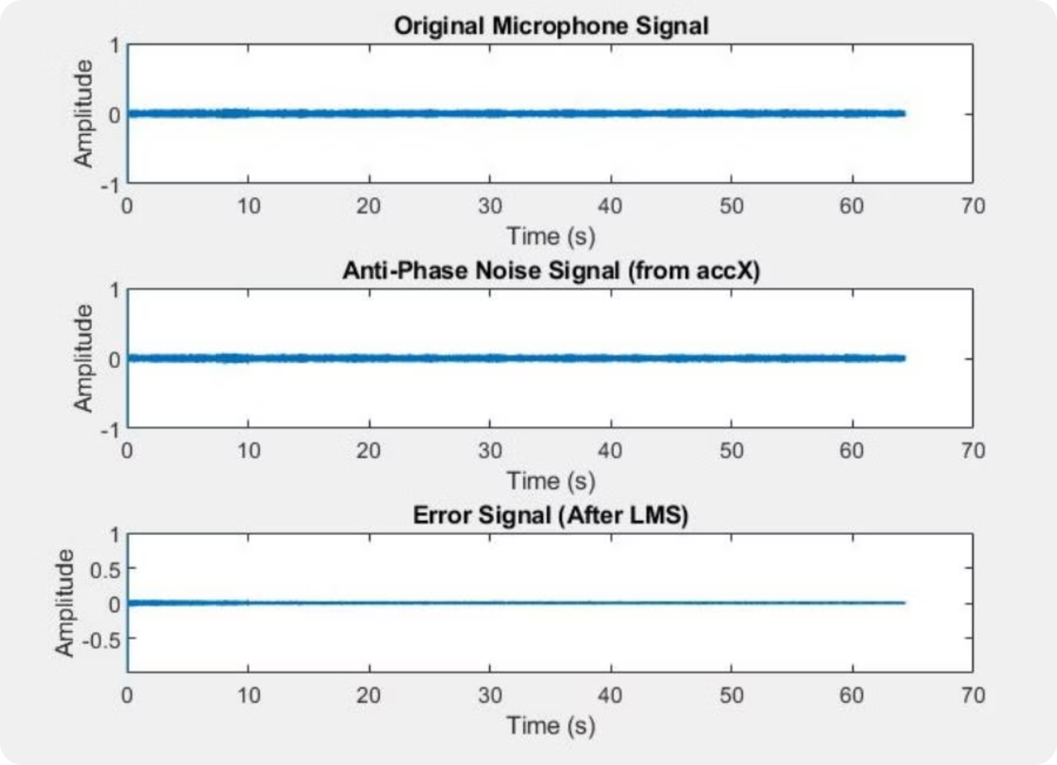



Stepwise Adaptive Filtering Approach
Process Sound + Noise Data
Analyze combined audio signals from microphone and IMU sensors.
Generate Inverted Phase Signal
Create anti-noise reference by inverting noise phase.
Apply LMS Filter
Use anti-noise as scaling factor to suppress noise components adaptively.
Visualize Results
Compare pre- and post-filtering audio signals for performance assessment.

Slide 7

Research Paper Study and Theoretical Insights
Dedicated time to studying research papers on adaptive noise cancellation, focusing on LMS algorithm parameter optimization. Gained several key theoretical insights:
Step Size (μ): Crucial for balancing convergence speed and algorithm stability.
Filter Order: Higher order tracks complex noise but increases computational load.
Convergence Rate: Dependent on step size and input signal characteristics.
Noise Reduction vs. Signal Distortion: A trade-off must be maintained; careful tuning is vital.
Real-time Processing Efficiency: Algorithm optimization for speed is essential.
Adaptive Filter Initialization: Starting values affect convergence behaviors.
Use of Reference Signals: Highly correlated reference signals improve suppression.
Performance Metrics: Incorporating MSE and SNR for quantitative tracking.

Slide 8
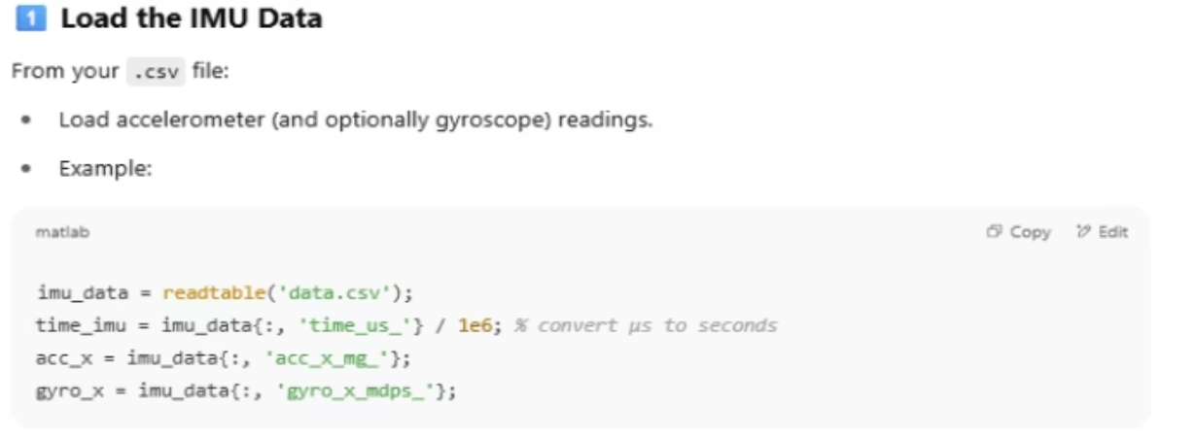
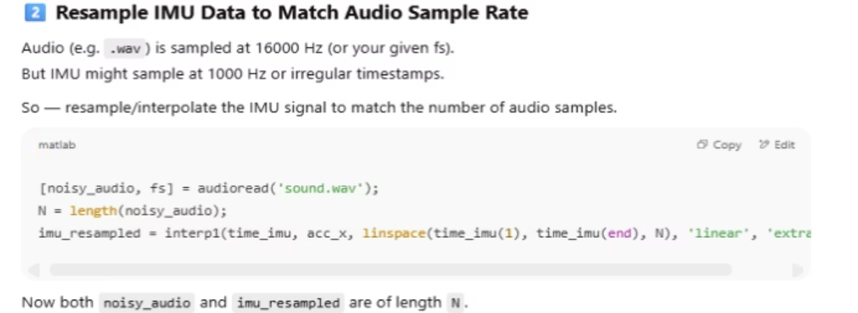
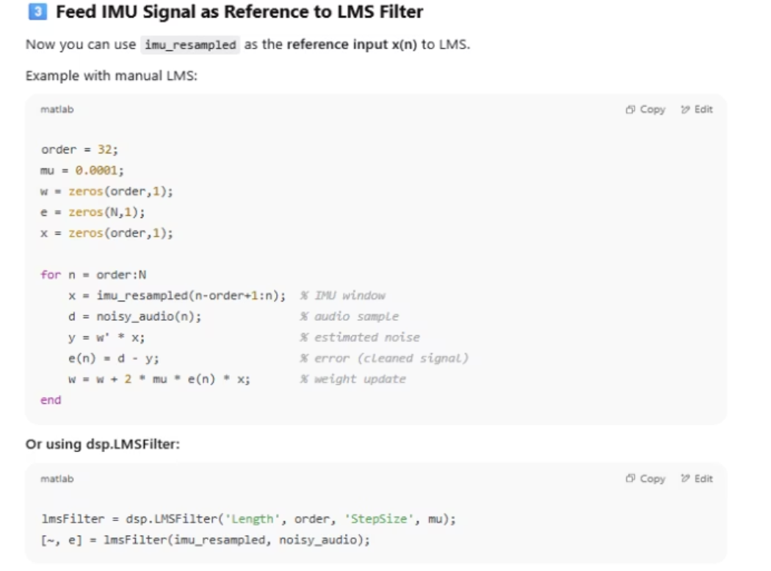
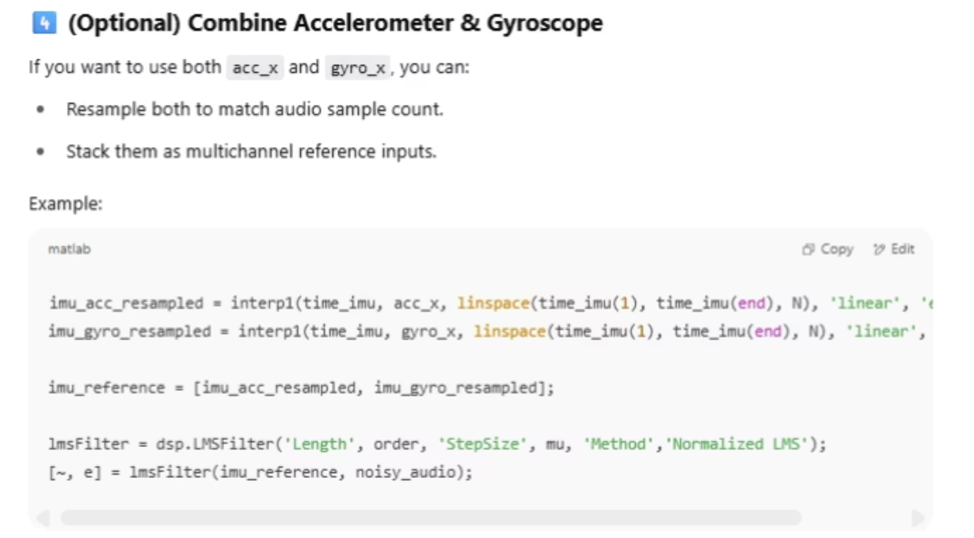
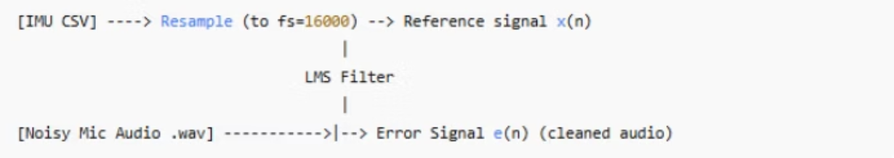
Math Behind LMS Filtering
Section 1
Section 2
After loading the data, column parameters such as time, accelerometer at x, y and z axis and Gyroscope at x, y, z axis are stored.
We resample the IMU(accelerometer, Gyroscope) data because the audio might be at 16000 Hz but IMU might be at 1000Hz or may have time delays.
Section 3
Section 4
As there are multiple column parameters e can use multichannel inputs into single unit. Then resampling it to take it in reference input.
The resampled IMU data is used as reference input in [x(n)]. It is later used in updating the weights [W]. The weights are used to make changes in actual output [Y]. This would make changes in error output signal [e(n)].
System Workflow

Slide 9
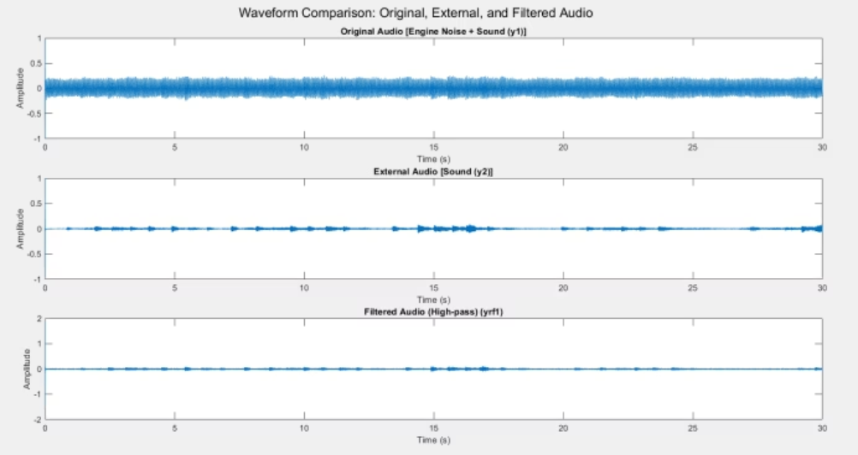
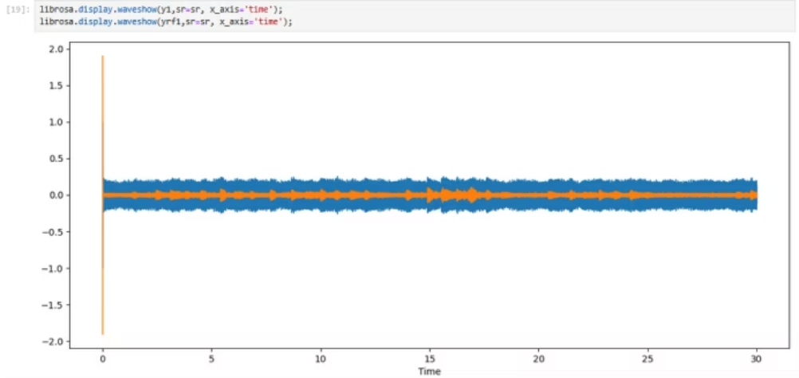
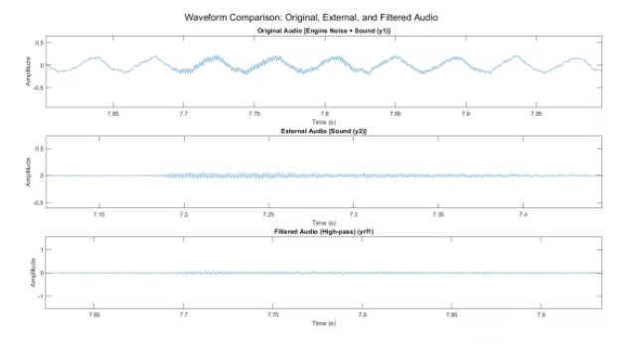
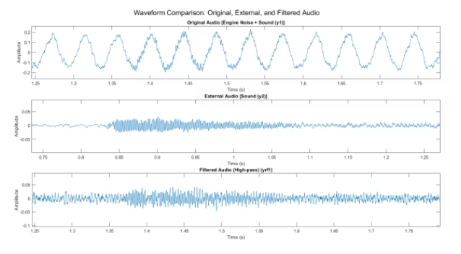
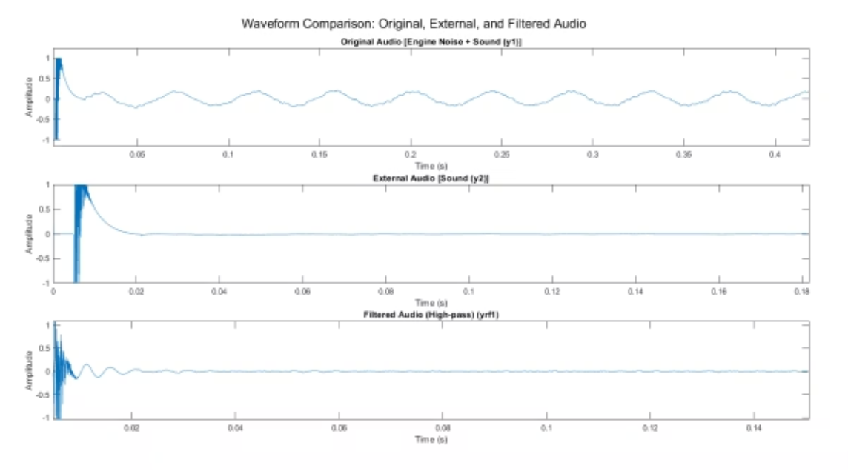
Experimental Analysis: SensorTile.box Data
Data 1: SensorTile.box
Performance Metrics
Analyzed data from SensorTile.box with car engine sound (v₁) and filtered sound (v₂). The error signal E(n) = v₁ - v₂ approximately isolated the external audio component or showed near-zero residuals if no external audio was present.
SNR: -2.5032 dB. Percentage Difference in Variance: 1.61%. Percentage Difference in Std Dev: 0.81%. Percentage Difference in RMS: 0.81%. Overall Pearson Correlation between y2 and yrf1: 0.1030. Overall PSNR between y2 and yrf1: 33.02 dB.
Visualization For Different Durations

Slide 10
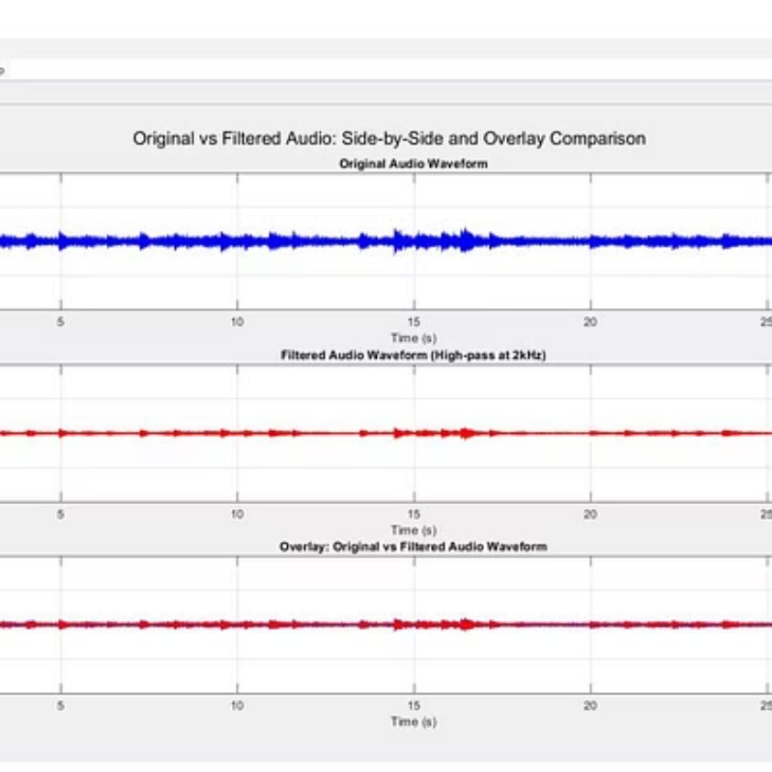
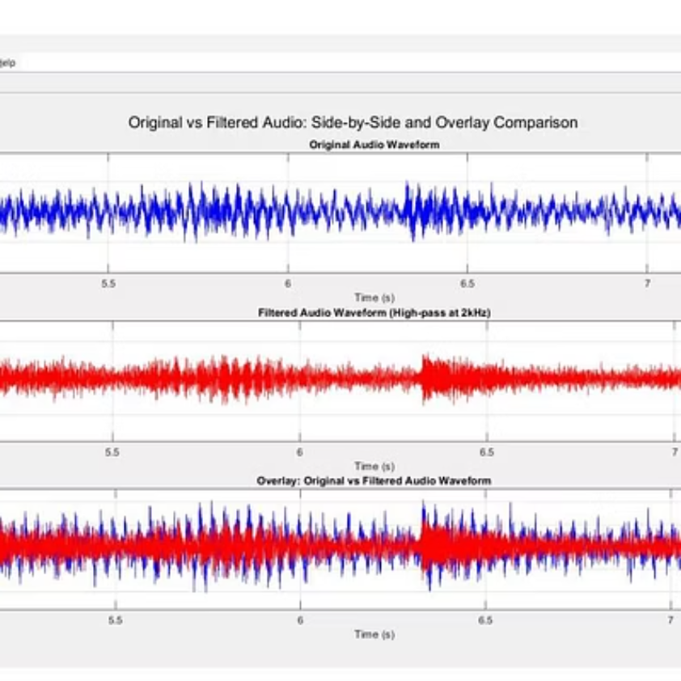
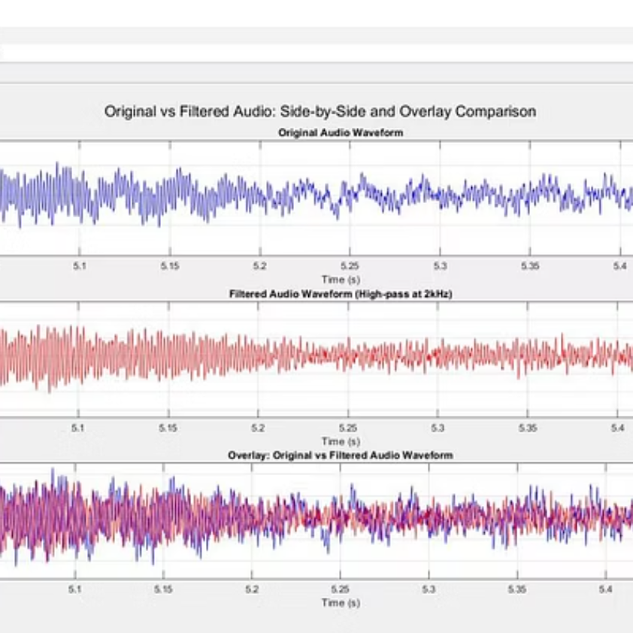
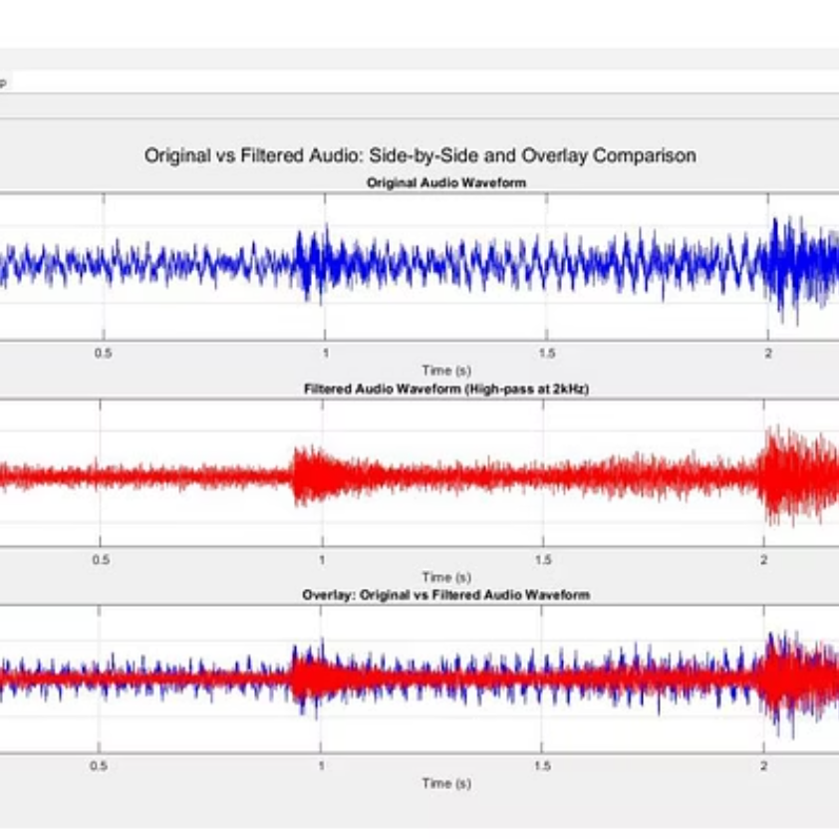
Analysis Summary: LSM6DSV16BX Sensor Data
This week, adaptive filtering analysis was conducted on three different data scenarios. In Case 1, using LSM6DSV16BX Sensor Data:
v₁ = Car engine noise (n) + Random external audio (S)
v₂ = Car engine noise (n) after adaptive filtering
E(n) = v₁ - v₂ ≈ S
The error signal reflected a cleaner and more precise extraction of external audio components, confirming the superior performance of the LSM6DSV16BX sensor's data in this application.

Slide 11
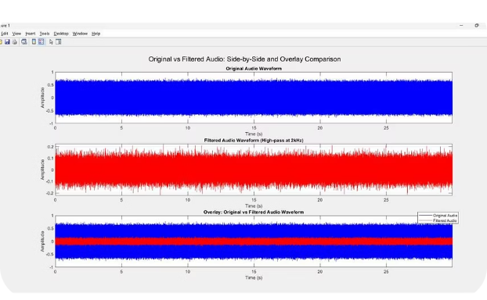
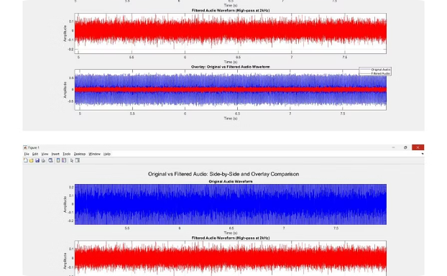
Analysis Summary: Simulation Data
In Case 2, using Simulation Data:
v₁ = Simulated car engine sound (n) + External Audio (S)
v₂ = Simulated car engine sound (n) after adaptive filtering
E(n) = v₁ - v₂ ≈ S
The LMS filtering behaved as expected in a controlled environment, validating the simulation setup as a reliable platform for further model development.
Simulated Noise Input
Filtered Output
Visual representation of the simulated car engine sound with external audio.
The resulting signal after LMS adaptive filtering, showing noise reduction.

Slide 12
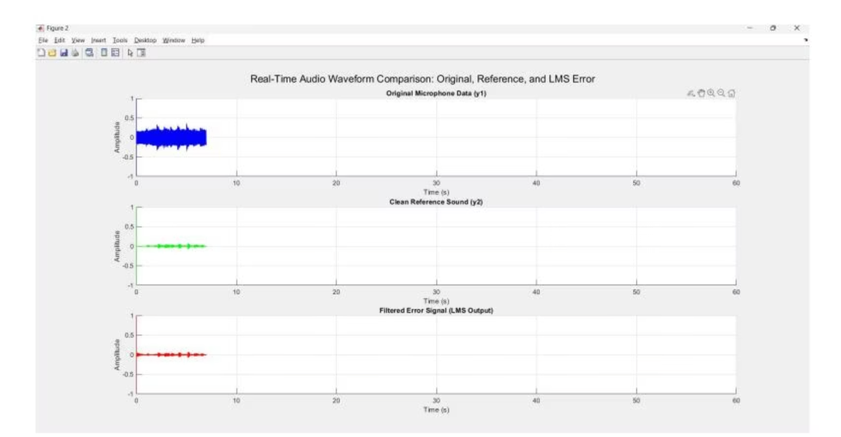
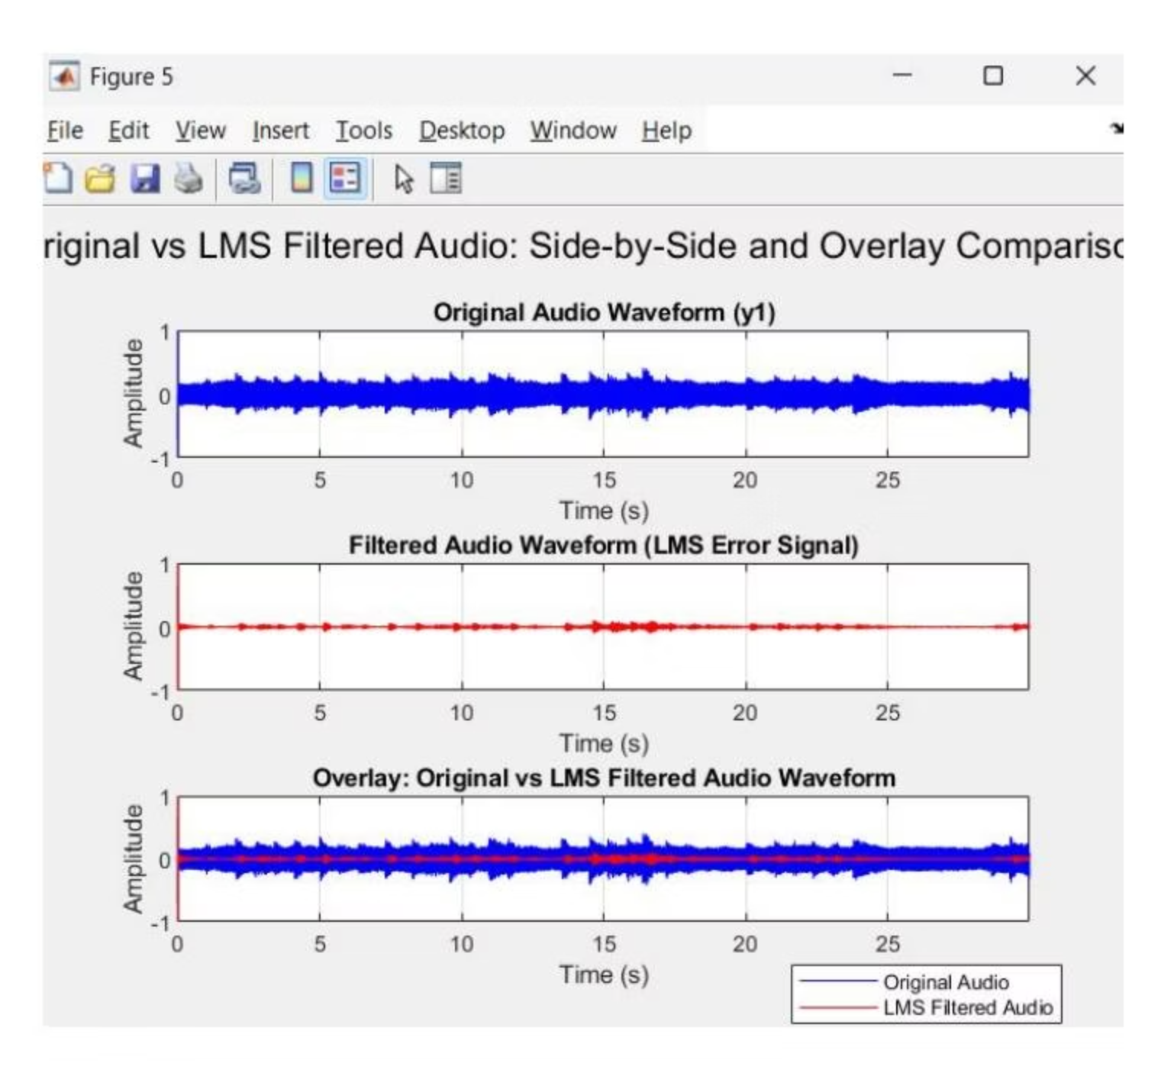
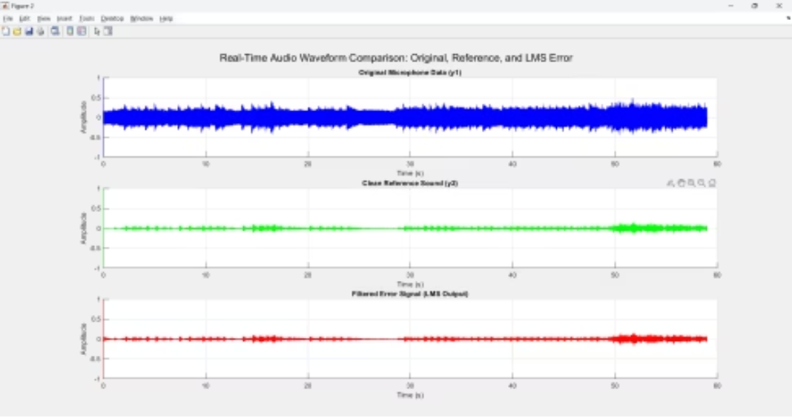
Data Cases and Observations
Case : Static Vehicle Real Time Data
Microphone captured static vehicle data with controlled external audio (music). The system effectively extracted the external audio component, confirming correct LMS filtering behavior.
Microphone and IMU captured data while the vehicle was moving with music and road/engine noise. LMS filtering effectively separated external audio despite dynamic motion, with minor inconsistencies due to sudden changes.

Slide 13
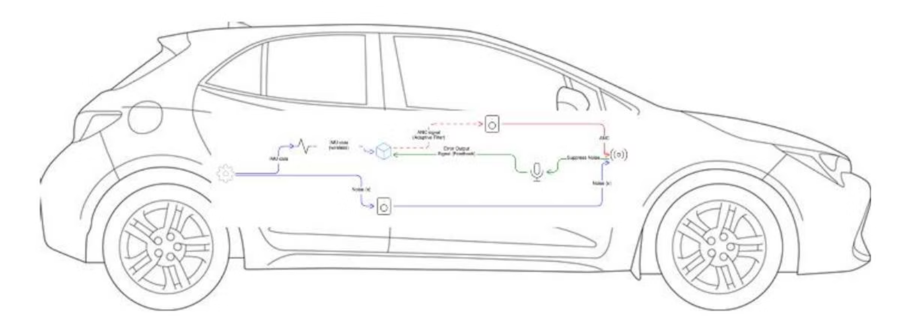
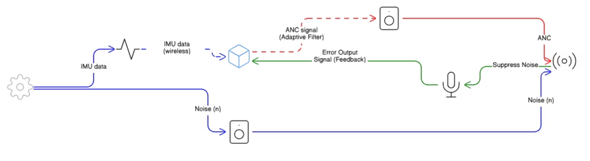
System for Car cabin
This prototype was designed for direct integration into the vehicle's interior, aiming for seamless noise suppression within the passenger compartment.

Slide 14
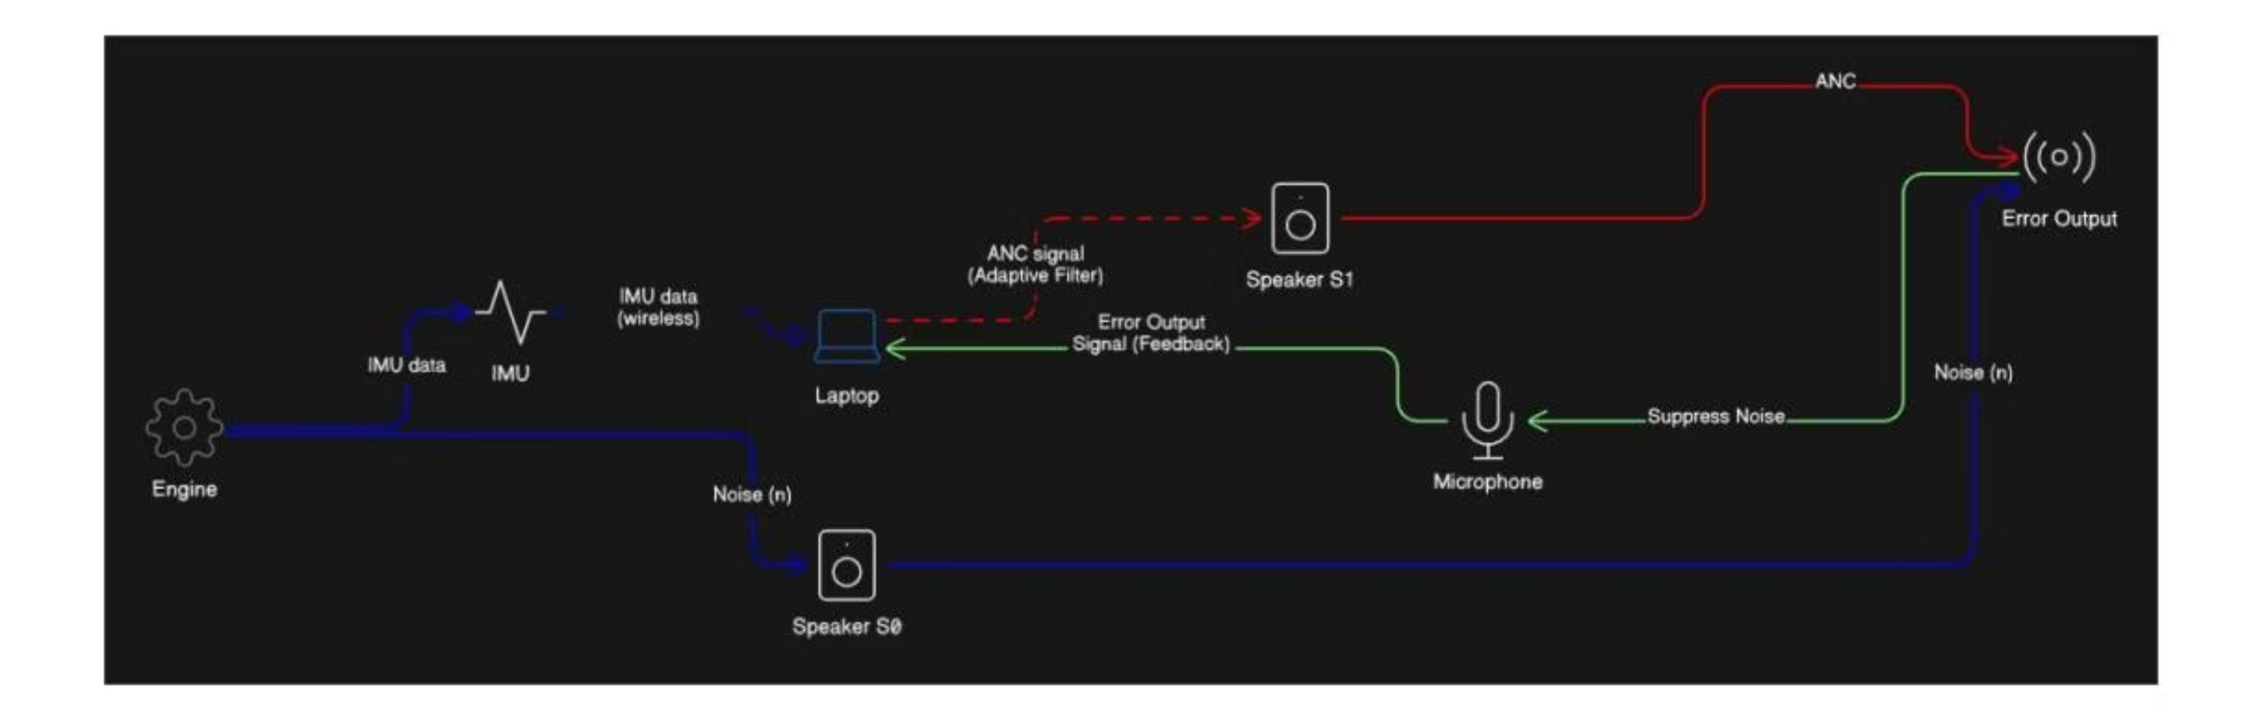
System Prototype
Two system prototypes were developed: one for integration within the car cabin and another as a replacement system.
Replacement System
An alternative system was developed as a replacement for the car cabin system, offering a different approach to active noise cancellation.

Slide 15





Next Steps: Future Development
The next phase involves developing a real-time feedback control system and refining the LMS filter parameters for dynamic conditions.
Real-Time Feedback Control
Develop and test a system linking error signal output to an anti-phase speaker system for real-time active noise cancellation.
Filter Parameter Refinement
Optimize LMS filter parameters, possibly using NLMS, for better stability in highly variable environments.
Speaker Integration
Complete real-time speaker integration, exploring different interfacing and buffering strategies to overcome feedback delay.
System Design Discussion
Conduct a detailed discussion on the end-to-end architecture of the noise suppression system.
Dynamic Data Collection
Continue gathering IMU and microphone data under diverse driving conditions for system training and validation.

